Slide 1
Guiding Principles
This event is meant for the pleasure of members of the HQ SACT Officers’ Mess and their guests. Mess members are permitted a partner and one guest couple at reduced price. Additional guests may be invited at full price ($95 per person). This is an adult affair, no persons under 21 years of age are permitted.
Non-mess members are permitted to attend at the sole discretion of the event organisers. Persons who are eligible to be regular Officers’ Mess members but choose not to become members are not allowed as guests.
There is a formal dress code that will be strictly enforced. Male officers should wear mess dress and other gentlemen must wear tuxedo. Female officers may wear either mess dress or ball gown and other ladies should wear ball gown. You must reserve a seat at www.officersmess.us and properly identify each person in your party. There is a maximum sign up of 300 for this event. By reserving a seat you agree that your mess bill will be debited for the appropriate amount even if for some reason you cannot attend. If you have issues, contact Wayne Buck at buck@act.nato.int. Only Wayne can deal with attendance issues.
2015 Buck-Hart Productions
HQ SACT Officers’ Mess Presents
Masquerade Ball
Friday, 20 March 2015
Hilton Virginia Beach Oceanfront
3001 Atlantic Avenue,
Virginia Beach, Virginia, 23451

Slide 2
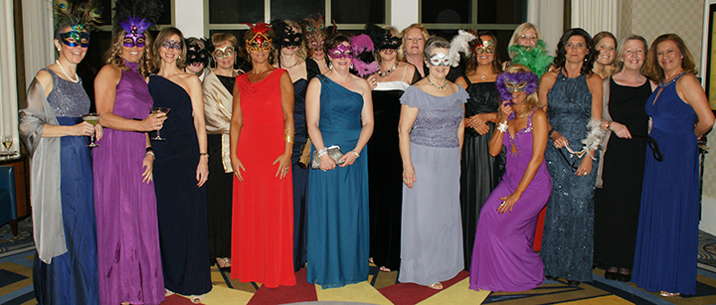
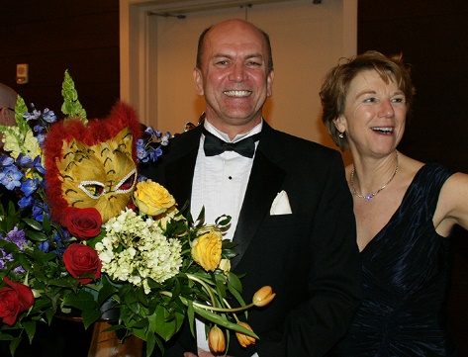
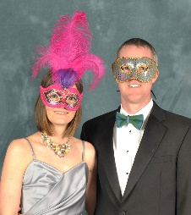
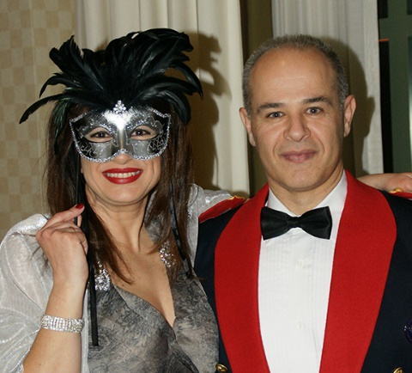
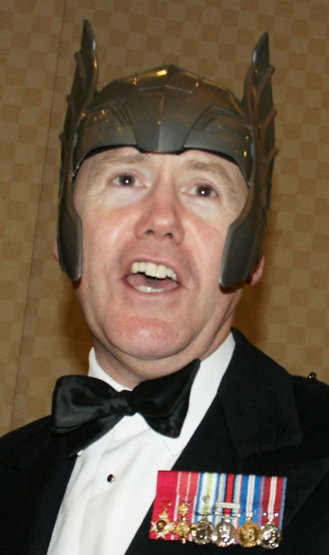
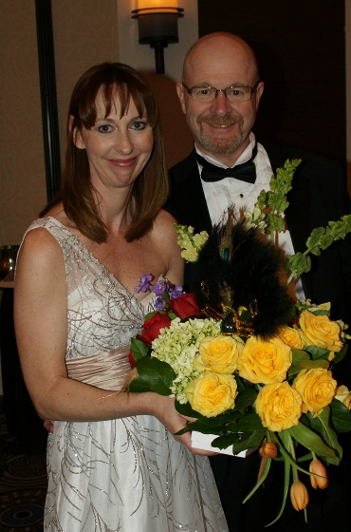
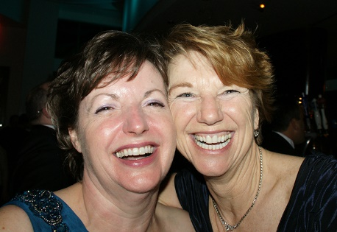
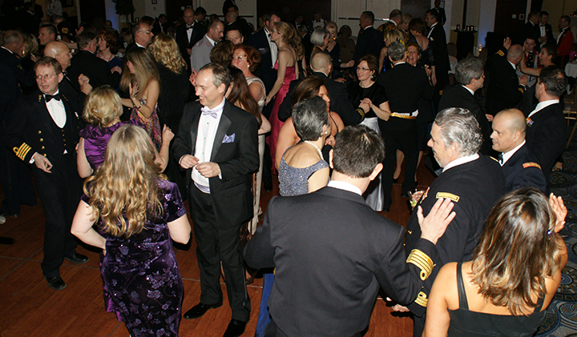
Masquerade Ball
Presented By
HQ SACT Officers’ Mess
20 March 2015, 1900-2400 hours
The Hilton Virginia Beach Oceanfront
Special NATO rate for rooms
$34.99 per person Price Includes:
3 Course Meal with Selection of
Steak, Chicken or Vegetarian
Free Drinks from 1900 to 2000 hrs
Including the Famous “Poinsettia” Drink
Mix of Red and White Wine on Table
Local Mixed Music Band – “Cheap Thrills”
Portrait Photographer
Favours
Military - Mess Dress
Civilian – Tuxedo (Black Tie) or Long Gown
( -> a business suit is not a tuxedo <- )
$34.99 Per Person. See Guidelines on Back Cover.
Registration begins on 13 February
www.officersmess.us

